Slide 1
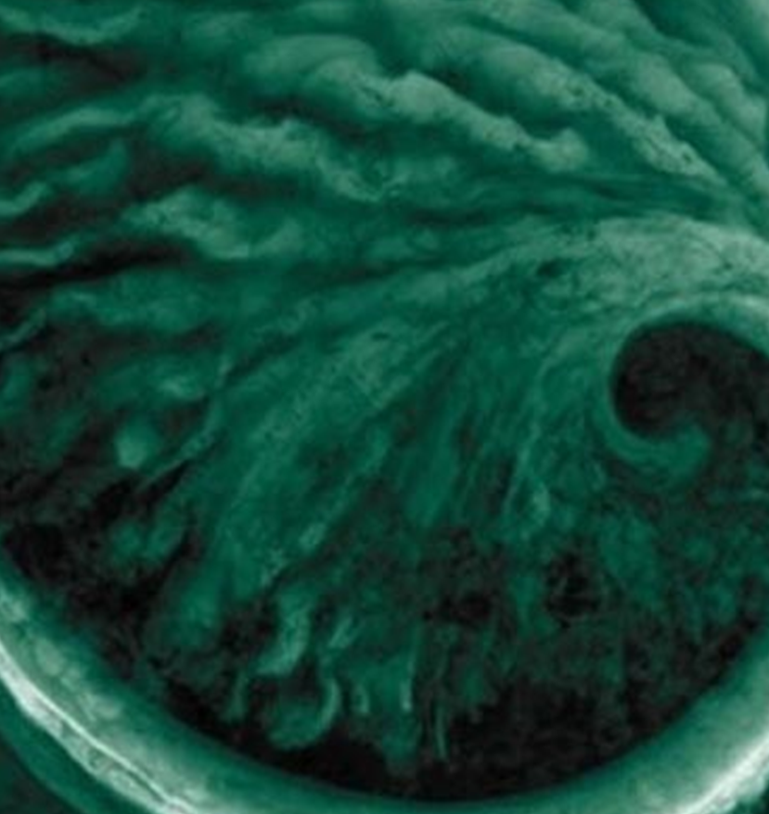
Derogation Process
Article 15(4) of the Industrial Emissions Directive (IED)
Derogation Reasons
Date: 27th April 2022

Slide 2
Derogation process overview
Request for an IED Article 15(4) derogation
Process
What is required
Status
1. Installation is BAT
Demonstrate the Site is compliant with the applicable BREF/BATc.
Undertake a site specific BAT assessment.
Complete.
2. Request compliant with legal requirements
Ensure compliance with legal requirements such as Environmental Quality Standards (EQS) and ensure no significant pollution is caused/ high level of protection of the environment.
Review legal requirements:
Undertake an H1 surface water risk assessment.
In progress.
3. Justification of an IED Article 15(4) request
Justify need for a derogation:
Geographical location or local environmental conditions of the installation concerned; or
Technical characteristics of the installation concerned
Identify and demonstrate justification reasoning
To be actioned
4. Assessment of cost and benefit
Demonstrate disproportionate cost against benefit.
Identify and screen all potential options.
Complete EA Cost Benefit Analysis (CBA) tool.
To be actioned
5. Disproportionality statement
Summaries disproportionality findings within a statement. Evidence based on CBA output, any additional factors and expert judgement.
Write up of disproportionality statement.
To be actioned
EA consider an IED Article 15(4) derogation request

Slide 3
Eligibility for a derogation
To be eligible for a derogation allowing for a deviation from best available techniques (BAT-AELs), the reasons should be due to the following:
the geographical location or the local environmental conditions of the installation concerned, e.g:
higher construction and/or energy costs due to remote location;
the installation uses a locally available raw material that affects the emissions, and importing the raw material upon which compliance with BAT-AEL depends would require substantial infrastructure investment and increased transport costs;
the uses of alternative techniques at the installation would require additional infrastructure locally (e.g. remote locations without interconnector for power supply);
the use of certain techniques is impossible due to the location, specifically techniques that do not operate effectively at very high or low temperatures, or at high altitudes;
(b) the technical characteristics of the installation concerned e.g:
A typical cross media impacts would arise whereby reducing the emissions of one pollutant increase the emissions of another;
the configuration of the plant within the site results in practical difficulties and increased costs, including lack of space for the construction of additional plant;
the general investment cycle for a particular type of installation;
the intended remaining operational lifetime of the installation as a whole or of the part giving rise to the emission of the pollutant(s), where the operator is prepared to commit to a timetable for closure;
Further examples are listed in SEPA’s guidance –
https://www.sepa.org.uk/media/399169/ied_tg_44_derogation_guidance.pdf

Slide 4
Huntsman Derogation Justification
Huntsman’s proposed justification for requiring a derogation for the CWW BREF BAT-AELs are for the following reasons:
the geographical location or the local environmental conditions of the installation concerned, e.g:
the installation uses a locally available raw material that affects the emissions, and importing the raw material upon which compliance with BAT-AEL depends would require substantial infrastructure investment and increased transport costs;
  the installation uses locally available Nitric Acid that contains sufficient Chromium and Nickel to result in the Huntsman S1 discharge not meeting BAT-AELs for those substances
  There is nowhere else in the UK /no other supply that can be used as an alternative.
  Importing the raw material upon which compliance with the BAT-AEL depends from other counties would result in the material travelling over significant distances, result in dramatically increased transportation costs, represent a safety risk through transportation of dangerous substances and may still not resolve the issue as Nitric Acid will leach Cr and Ni from stainless steel.
(b) the technical characteristics of the installation concerned e.g:
atypical cross media impacts would arise whereby reducing the emissions of one pollutant increase the emissions of another;
  Treatment of the Cr and Ni (under investigation) may result in requirement for use of considerable quantities of dosing chemicals to precipitate the metals due to the low concentration of Cr and Ni.
atypical cross media impacts would arise whereby reducing the emissions of one pollutant increase the emissions of another;
  Use of alternate Ni catalysts has been extensively trialled in the operating plant and resulted in similar releases of Nickel

