Slide 1

Woodcote Wood quarry
Site induction for visitors and contractors
383NRS:CVI:01A

Slide 2
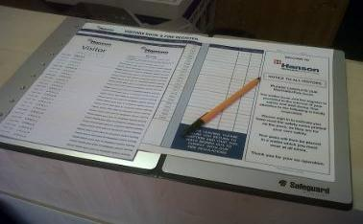
Signing in and out procedure
  It is vitally important that the site management know who is on site at any time. This will enable NRS personnel to carry out an effective roll call and account for all personnel on site in the event of an emergency.
  All visitors and contractors must contact the Quarry Manager before signing themselves onto the site using the signing in book located in our main reception.
  All visitors and contractors must also contact the Quarry Manager before signing themselves out every time they leave site.
383NRS:CVI:01A

Slide 3

Standards of conduct
Whilst on site you are expected to maintain an appropriate standard of behaviour and conduct at all times.
This includes:-
Suitable behaviour towards the people you work with.
Maintaining a safe and pleasant environment to work.
Maintaining high standards of housekeeping and cleanliness.
Appropriate care and respect for all company plant, property and equipment.
Reporting all incidents relating to mistakes, defects, damage and safety issues in an appropriate way to the Quarry Manager or Supervisor.
It is important for all contractors to be cooperative with site staff to avoid any unnecessary incidents or conflicts.
If you feel your safety is being compromised then do not proceed and raise the issue immediately with the Site Staff around you and/or the Quarry Manager or Supervisor.
383NRS:CVI:01A

Slide 4
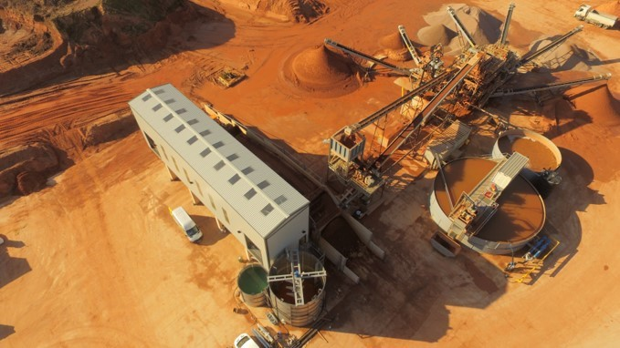

Slide 5
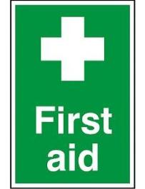
Emergency procedures
In the event of an emergency, firstly ensure any alarm or warning system is raised to warn others working around you.
Secondly ensure that the Quarry Manager or Supervisor is made aware of the incident.
They will Manage the following:-
Initial First Aid provisions.
Notifying and dealing with emergency services.
Evacuation of site personnel.
Liaising with all other parties within the quarry site.
First aid kits are located in the Main Office, the Weighbridge Office, the Plant Control Room and the Workshop.
383NRS:CVI:01A

Slide 6
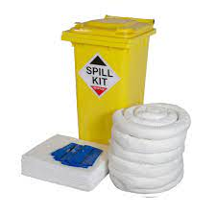
Environmental Incidents
All staff, contractors and visitors have a responsibility to work safety and correctly and use chemicals, fuels and oils only if trained to do so.
Any accidents or incidents MUST be contained as best as possible and the incident reported to the Quarry Manager or Supervisor immediately.
Spill kits are available at certain designated points around the processing plant, yard and workshop area. Anytime they are used MUST be reported to the Quarry Manager or Supervisor.
383NRS:CVI:01A

Slide 7
Fire procedures
All work that has the potential to cause a fire risk must be controlled under a Permit to Work authorisation which can only be issued by the Quarry Manager.
Do not put any of your equipment, tools, belongings etc in a place that could block or obstruct fire exits and fire fighting equipment.
Do not allow your workspace to become cluttered with flammable materials.
If you discover a fire raise the alarm immediately.
Do not attempt to fight a fire, unless you have been trained to do so.
The site Responsible Person will assess the situation, and will deal with the emergency in the appropriate manner.
If evacuated the assembly point is located at the exit end of the weighbridge. All personnel must proceed to the assembly point immediately without stopping to collect belongings. Personnel must not return to the place of work until the all clear has been given by the Responsible Person.
383NRS:CVI:01A

Slide 8
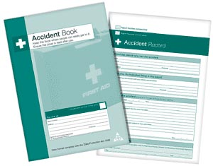
Accident and incident reporting
It is extremely important that you report incidents to the Quarry Manager who will ensure that the hazards are controlled and that relevant documentation is completed.
The following incidents MUST be reported BEFORE leaving site.
ALL accidents which result in personal injury or damage to property.
Any incident that did not result in damage or injury, but could have if the circumstances were different (a Near Hit/Miss).
Any environmental incident such as chemical spill, potential groundwater or surface water contamination.
Any incident occurs that has the potential to cause lost time, MUST be escalated to the Quarry Manager immediately.
383NRS:CVI:01A

Slide 9

Risk assessment and safe working practices
  Contractors must report to the Quarry Manager prior to any work commencing.
  No task may be undertaken without a suitable risk assessment and safe system of working practice method statement.
  This may be a full risk assessment or a Point of Work Assessment.
  A Permit to Work authorisation may be required depending on the task being carried out, which will only be issued by the Quarry Manager.
  You must work in a safe manner, adhere to all site safety rules and ensure that your designated work area is kept clean, tidy and hazard free at all times.
  If the method of work changes or the environment around the work area changes, the risk assessment and safe system of working practice MUST be reviewed and adjusted to take in consideration these changes.
383NRS:CVI:01A

Slide 10

MOBILE PHONES MUST NOT BE USED:
Whilst driving any vehicles
Whilst operating any machinery
Whilst re-fuelling plant and equipment
Do not use Ipod’s or MP3 player headset etc whilst driving on company business
Personal mobiles must not be answered in the workplace, only at convenient break times in safe areas
When using a mobile phone personnel must be aware of the potential risks that maybe present wherever they are on site, for example moving mobile plant and road traffic.
383NRS:CVI:01A

Slide 11

There are legal requirements contained in the
Personal Protective Equipment at Work Regulations 1992.
The following items are mandatory on our site:
Suitable safety head protection
Suitable safety footwear
High visibility clothing (waistcoat/jacket and over-trousers)
Safety eye protection (glasses or goggles)
Gloves to be worn suitable for the work being carried as per the job risk assessment
Other PPE will be indicated by signage or identified in risk assessments such as ear defenders
Contractors must provide their own PPE as described above and ensure it is fit for purpose.
383NRS:CVI:01A

