Slide 1
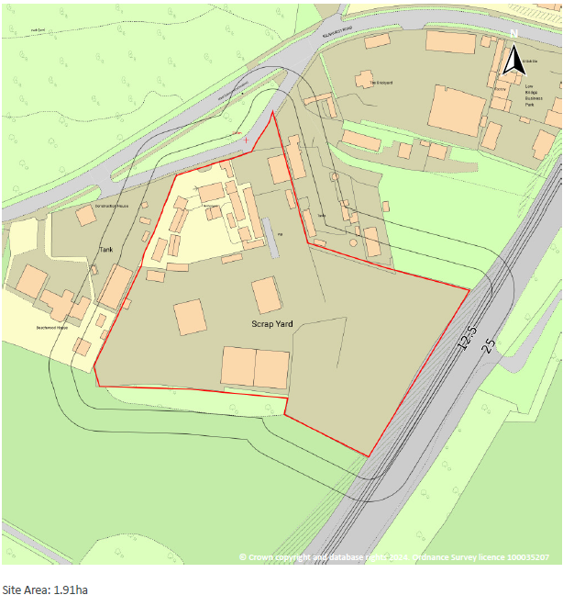
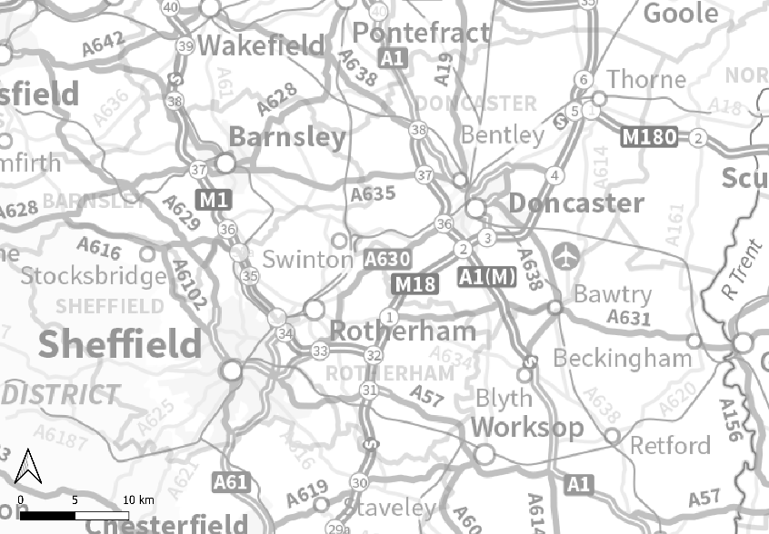

Source:GS-32I-USE-C26-CVE
Figure 1 Site Location
MLB Autospares Ltd
EPR/BB3507XB/V002

Slide 2
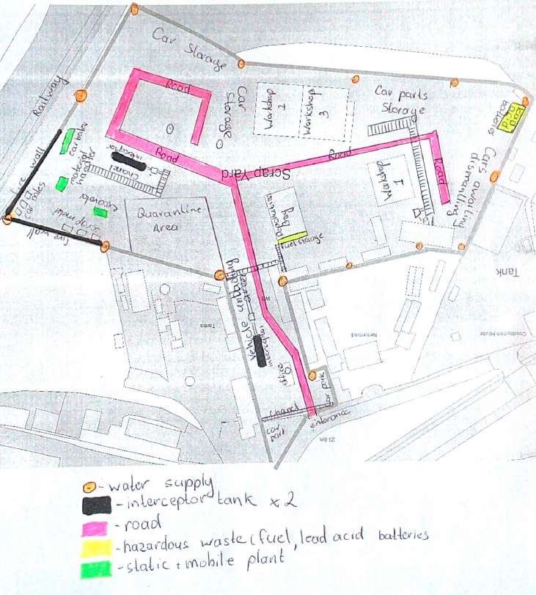
Figure 1 Site Layout
MLB Autospares Ltd
EPR/BB3507XB/V002

Slide 3
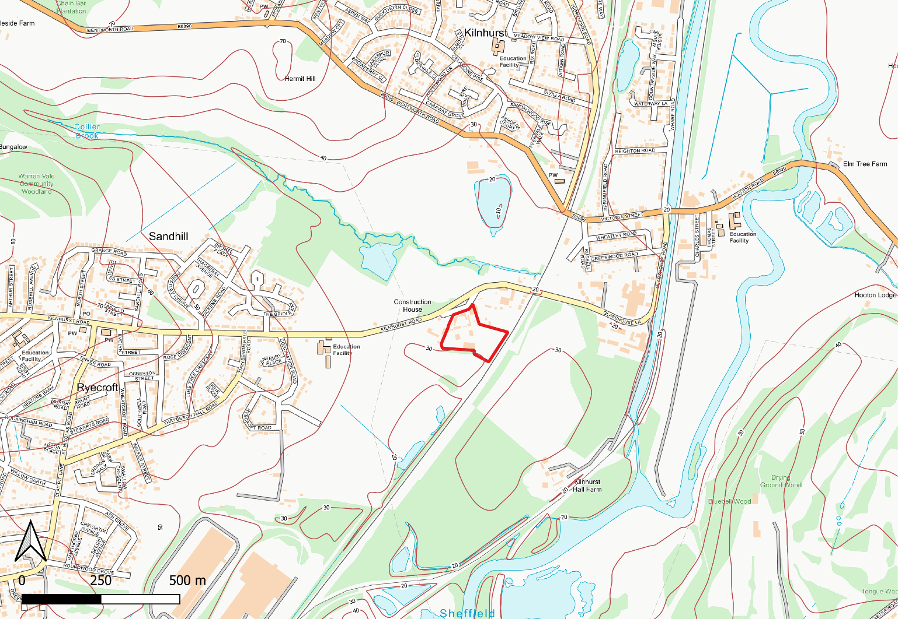
Contains OS Data Crown © Copyright & Database Right 2025
Produced using http://www.qgis.org
Figure 3 Topography
MLB Autospares Ltd
EPR/BB3507XB/V002

Slide 4
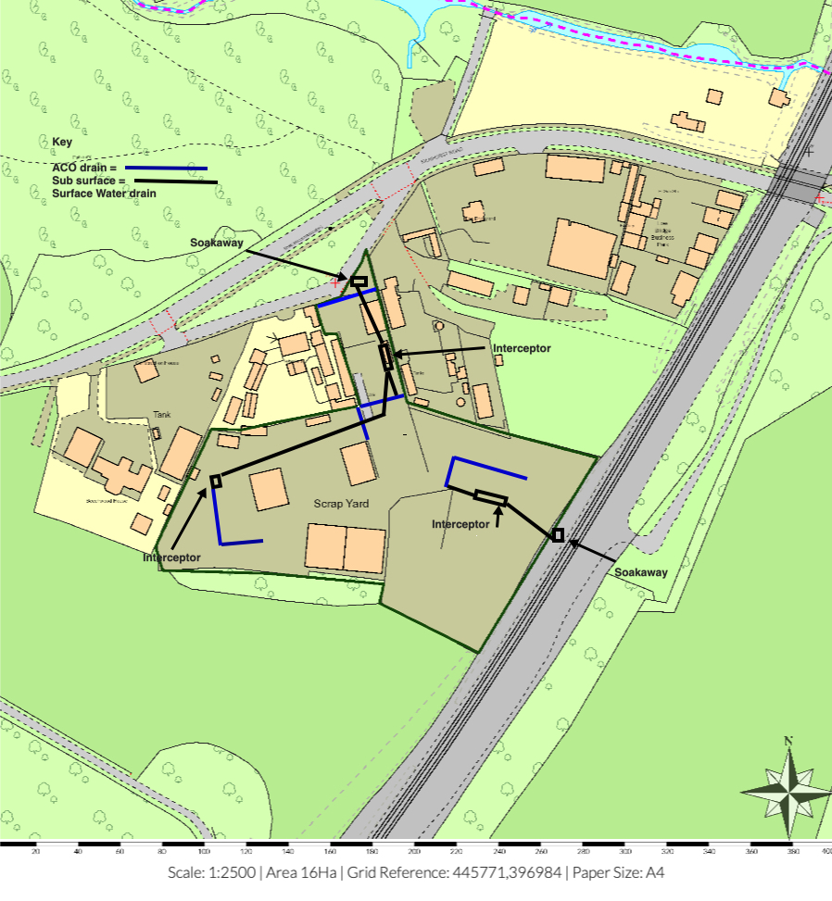
Figure 4 Drainage Layout
MLB Autospares Ltd
EPR/BB3507XB/V002

Slide 5
System 1
System 2
System 1 = 8832m²
System 2 = 7328m².
Figure 5 Surface Area
MLB Autospares Ltd
EPR/BB3507XB/V002

Slide 6
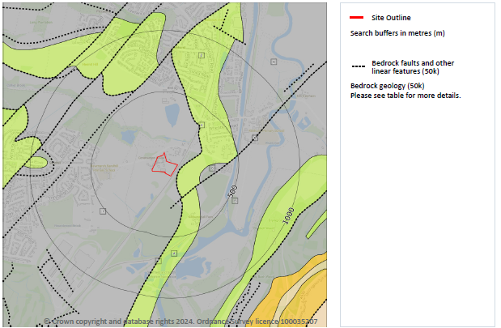
Source:GS-32I-USE-C26-CVE
Figure 6 Geology
MLB Autospares Ltd
EPR/BB3507XB/V002

Slide 7
South North
The Site
Precipitation
Interceptor Discharges to Soakaways
Surface Water Feature 89m North
Groundwater Flow
Pennine Middle Coal
Measures Formation
Groundwater assumed to be within 10m of ground level;
Surface water captured in Acco drains and conveyed via interceptors to soakaway discharge;
Migration through Pennine Middle Coal Measures, predominantly via fractures and sandstone
horizons;
Attenuation in unsaturated zone and saturated zone, high fraction of organic carbon and
dilution beneath the site.
Not to Scale
Figure 7 Conceptual Site Model
MLB Autospares Ltd
EPR/BB3507XB/V002

