Slide 1
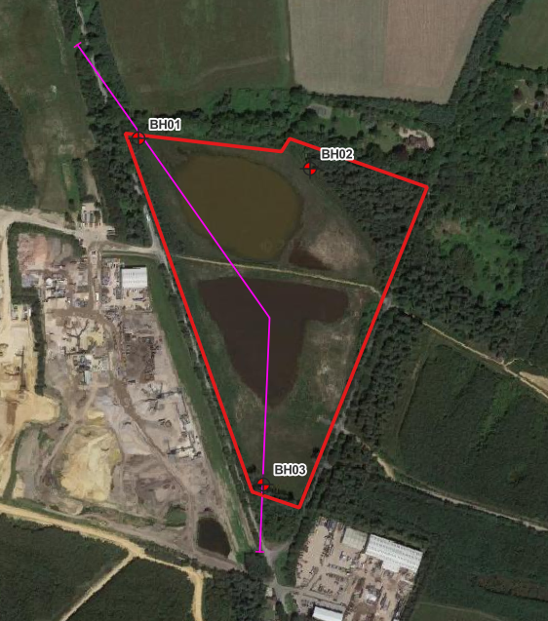

Key:
River Terrace Deposits–
Sand and Gravel
Mineral working over and interburden–
Silt and Clay
Camberley Sand Formation –
Sand, Silt and Clay
Groundwater Level, from monitoring data, June 2024
Site Boundary
S
Site Boundary
NW
100m
98m
96m
BH03
South Pond
Existing Bridleway
North Pond
Proposed Restoration Profile
BH01
94m
92m
90m
88m
86m
84m
82m
80m
0m
100m
200m
300m
400m
500m
600m
700m
800m
Figure 4A: Hydrogeological Conceptual Site Model (CSM)
Client: Collard Environmental
Project: B068370 – Busta Triangle
Note: Sections vertically exaggerated.
Date: November 2024
Author: MP
Checked: PM

Slide 2
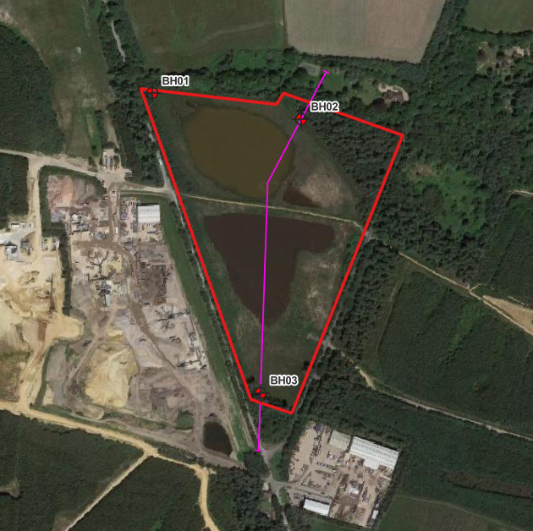
Key:
River Terrace Deposits–
Sand and Gravel
Mineral working over and interburden–
Silt and Clay
Camberley Sand Formation –
Sand, Silt and Clay
Groundwater Level, from monitoring data, June 2024
Site Boundary
S
Site Boundary
N
100m
98m
South Pond
96m
BH03
Existing Bridleway
North Pond
94m
Proposed Restoration Profile
BH02
92m
90m
88m
86m
84m
82m
80m
0m
100m
200m
300m
400m
500m
600m
700m
800m
Figure 4B: Hydrogeological Conceptual Site Model (CSM)
Client: Collard Environmental
Project: B068370 – Busta Triangle
Note: Sections vertically exaggerated.
Date: November 2024
Author: MP
Checked: PM

