Slide 1
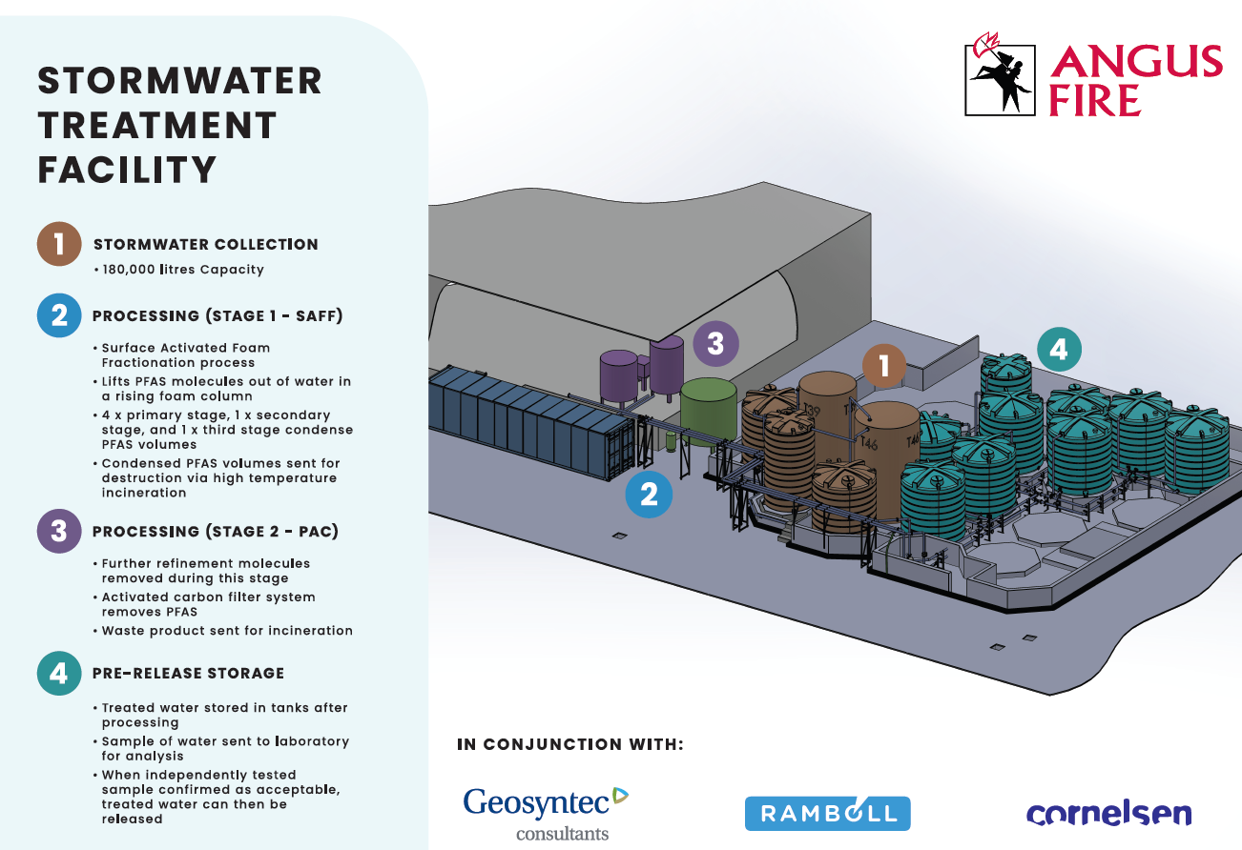

Slide 2

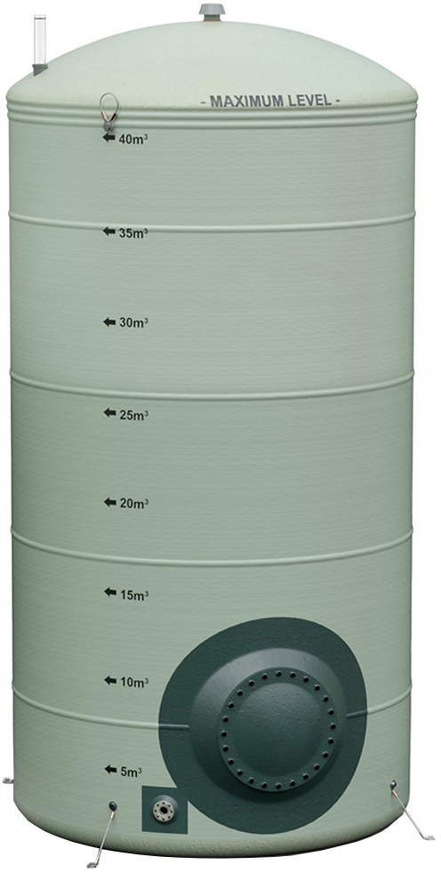
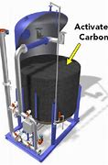
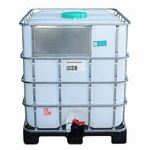
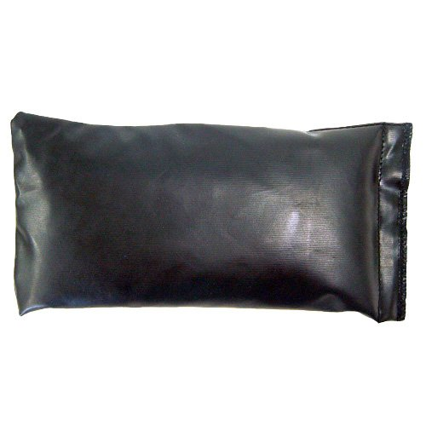
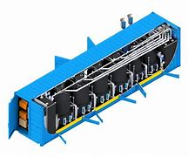
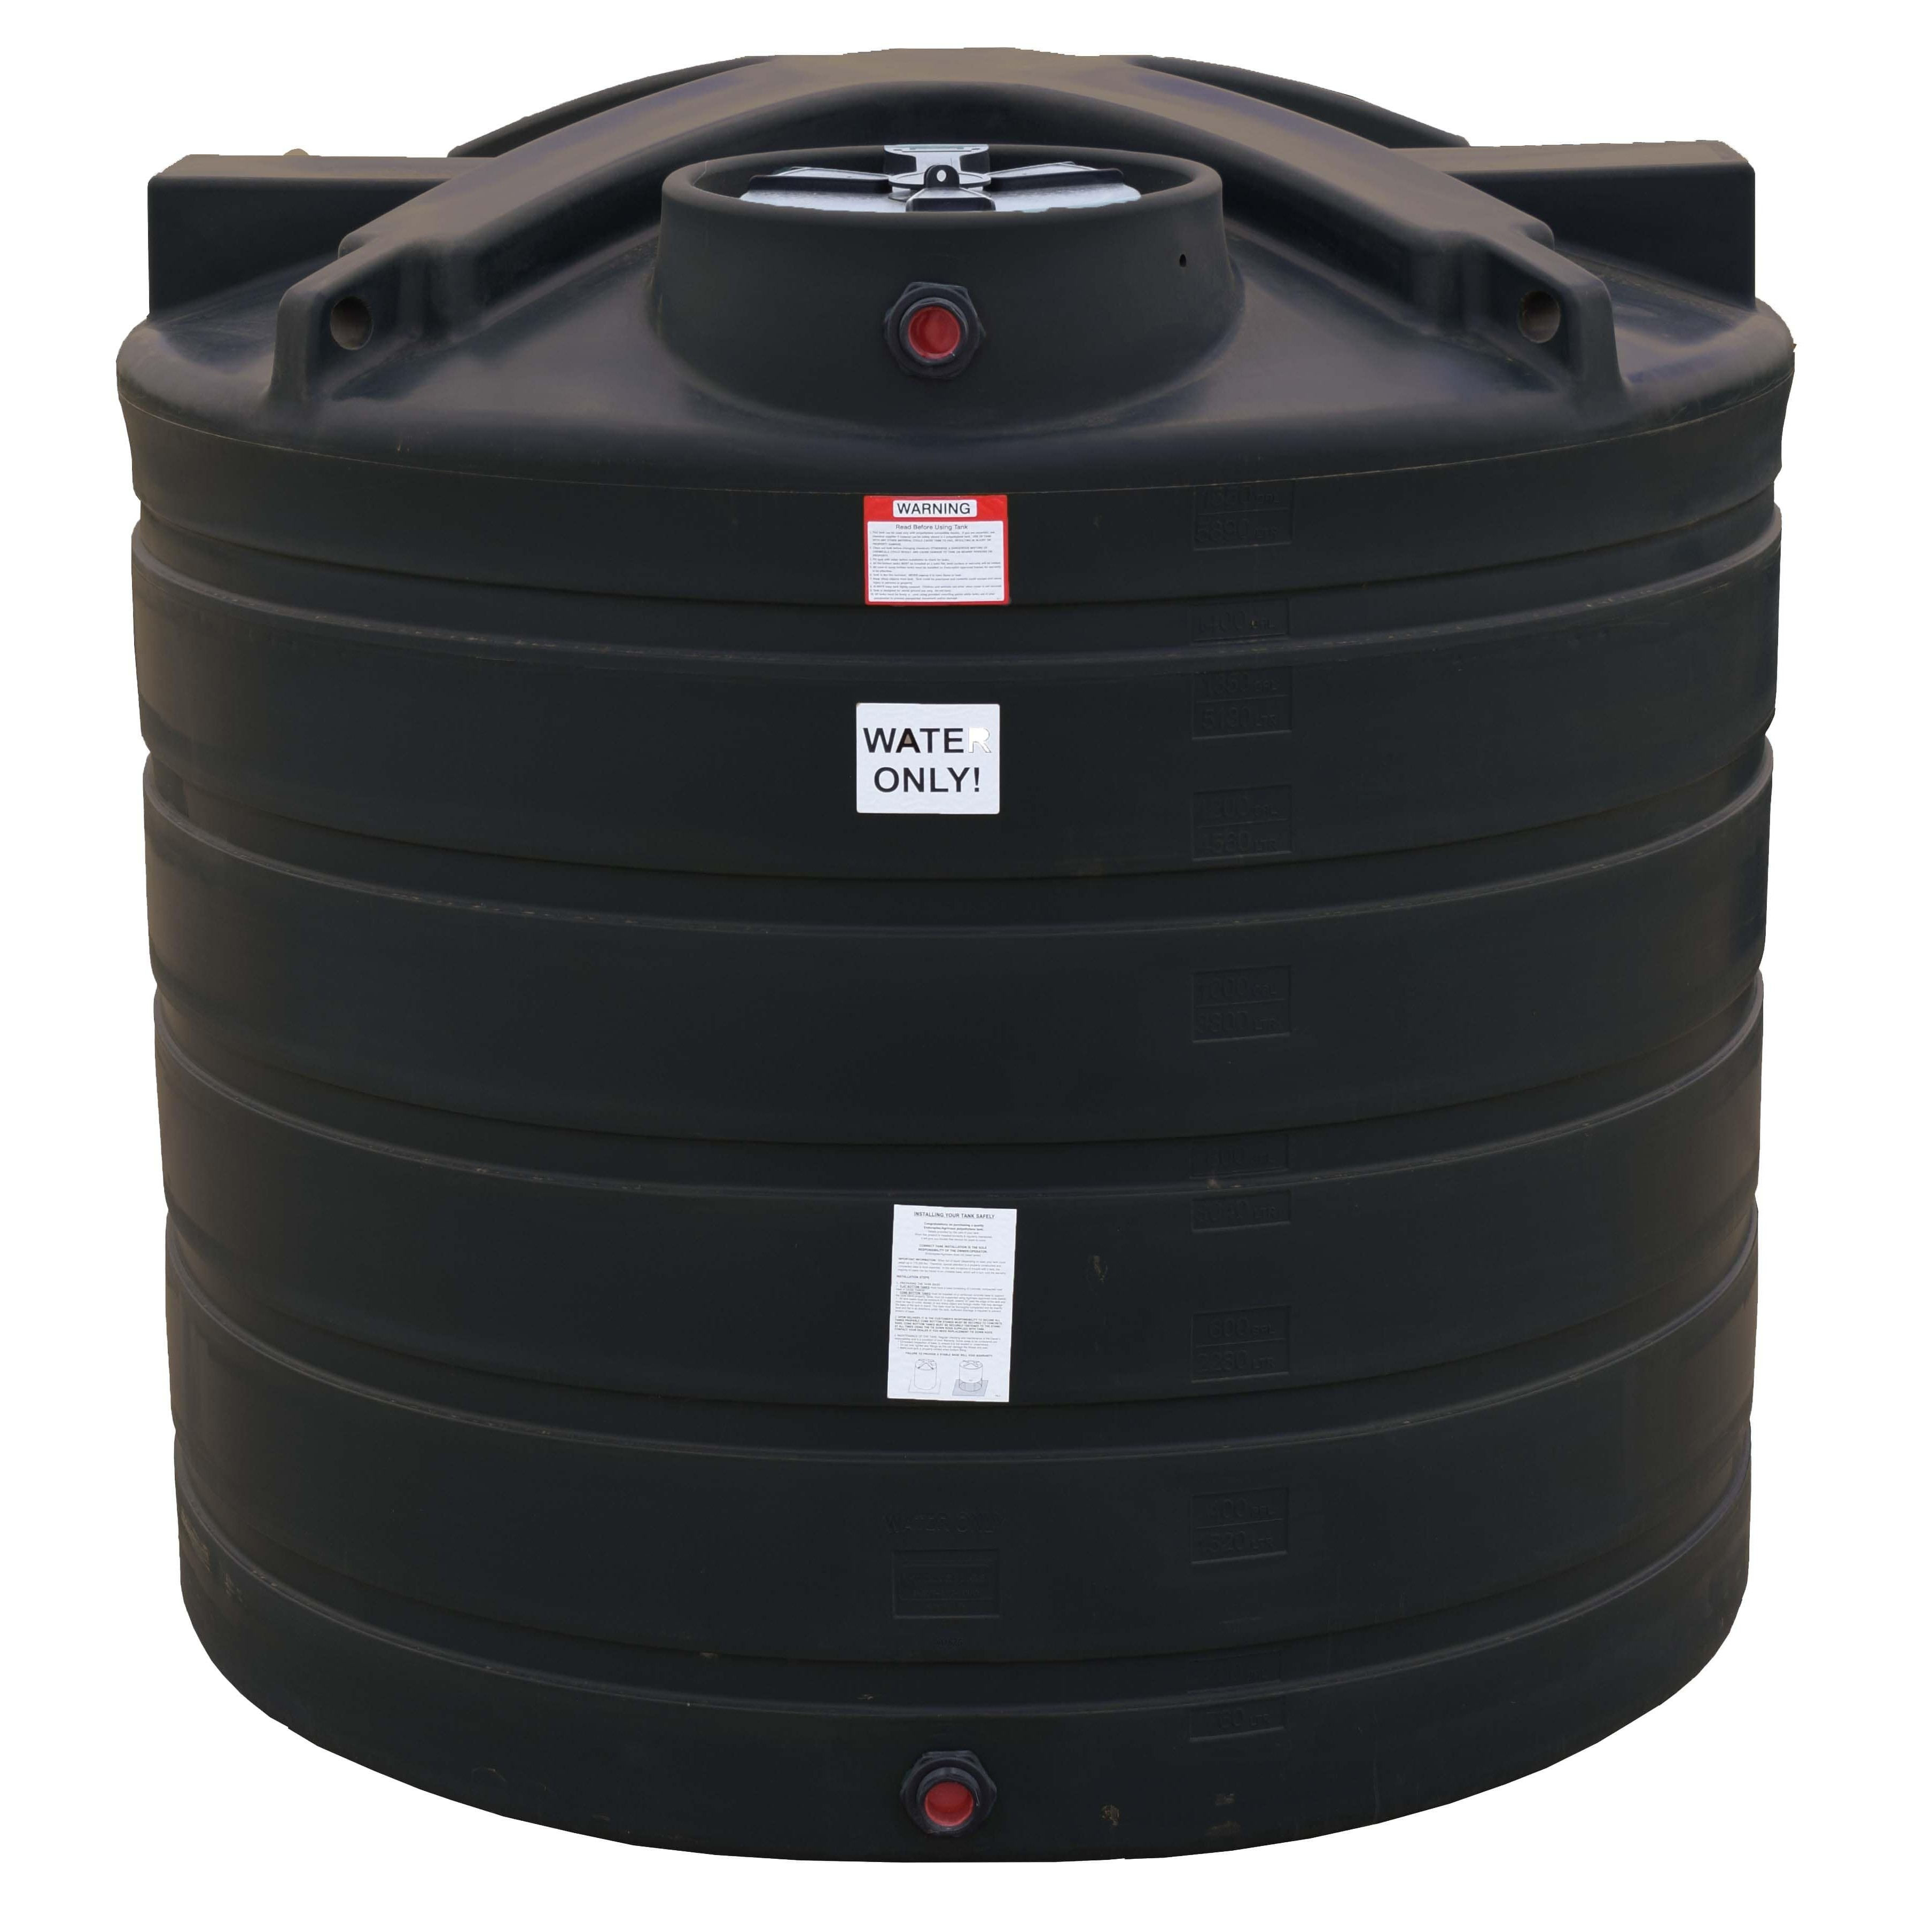
SITED EXTERNALLY
Overflow Feed
Overflow Feed
SITED INTERNALLY
INFLUENT STORAGE TANKS (STORMWATER)
PAC Sludge filter (Water drained for re-circulation, waste sent via EWC)
PAC
Powder Activated Carbon (PAC introduced at pre-determined and digitally controlled dose)
Tank A1
Glass Fibre Laminate
39m³
Tank A2 Stainless Steel
40m³
SAFF
Surface Activated Foam Fractionation
SAFF Effluent (Extracted content retained in internal tank)
PAC and Discharge Tanks Control Systems
(SAFF has its own internal system controls)
Overflow Feed
SAFF Influent (Pulled to internal Feed Tank)
Tank A4
MDPE 30m³
Tank A3
MDPE 25m³
Tank A5
MDPE 30m³
PRE-DISCHARGE HOLDING TANKS
Bottom Manifold Feed
PAC Processed Water pumped to clean storage tanks pending sample laboratory analysis
Tank B10
MDPE 30m³
Tank B11
MDPE 30m³
Tank B12
MDPE 30m³
Tank B13
MDPE 30m³
Tank B14
MDPE 30m³
Captured Stormwater Feed from Drainage System and Water Capture Bund
PROCESS START
Tank B18
MDPE 30m³
Tank B17
MDPE 30m³
Tank B16
MDPE 30m³
Tank B15
MDPE 25m³
PROCESS FINISH
Discharge Route (Controlled volume/flow rate)

Slide 3
Process Flow – Task/Interaction/activity based
KEY TO COLOUR CODING
Automated process stage
Requires Operator interaction
Processing parameters are preset within the SAFF, PAC & Discharge Control Systems and all settings password protected
under engineering and admin access rights
CYCLE START
SAFF Cycle enabled (within PLC Control System)
PAC Cycle enabled (within PLC Control System)
Discharge Cycle (within PLC Control System)
Batch sample taken within 12 hours of notification?
Influent Tank level above warning level?
Automated email issued to notify low influent warning
NO
System advises that a test sample must be taken
NO
Automated email to notify batch sample not taken
YES
YES
Is this batch the first fill since a discharge was completed?
YES
Influent Tank level
re-established
Primary Processing Cycle Operates
in individual batch vessels
PAC Cycle runs once post SAFF influent is available
PAC Polyclay is dosed at preset rate (circa 1kg per 1m³) over 1 hour cycle
Batch sample taken and issued to Lab
Lab Report received
NO
Secondary Processing Cycle (Refinement of waste product)
Operator enters EMT reference number and PFOS result (ng/l)
Is this the last available free tank in a discharge sequence?
PFOS > 10ng/l
Discharge Tanks Remediation activity
NO
PFOS < 10ng/l
Waste byproduct transferred to storage tank ready for disposal
Waste disposed of via appropriate EWC
Polyclay sludge from batch is pumped to filter bag
DISCHARGE CYCLE COMMENCES
YES
Processing automatically stops once all tanks filled

Slide 4

ANGUS FIRE STORMWATER TREATMENT TRAIN – TANK DISCHARGE PHILOSOPHY
1
Starting position of 9 discharge tanks, connected under stringent control conditions, and each with feed and discharge controlled by independent/remotely actuated gate valves.
The 9 tanks are identified within the PLC as B10 to B18.
B10
B11
B12
B13
B14
B15
B16
B17
B18
2
As the cycle starts the PLC will open the valve on the input manifold into B10, the first tank in the cycle. The tanks will only ever fill or discharge sequentially.
A sample is taken from the feed line after the PAC and is immediately sent for external Lab testing.
B10
B11
B12
B13
B14
B15
B16
B17
B18
3
As the cycle continues the PLC will open the valve on the input manifold on sequential tanks until all tanks are filled. Fill level is controlled by an internal level sensor. The Stormwater Treatment Train will automatically stop processing once discharge tanks are full (or the stormwater influent feed tanks are below a pre-set level).
B10
B11
B12
B13
B14
B15
B16
B17
B18
4
Once test sample results are confirmed to meet agreed discharge concentration levels the discharge cycle is started. This requires the Lab Report reference number and reported concentration of <10ng/l PFOS to be entered into the PLC control system. Without this data, the system will not allow discharge. The discharge process begins sequentially at the rate of 2m³ /hr as programmed into the PLC.
✓
B10
B11
B12
B13
B14
B15
B16
B17
B18
5
The cycle will open the valves on the discharge manifold sequentially (starting at the first tank filled) until all tanks are released. The valve aperture is determined by the discharge rate and the mechanical flow restrictor on the discharge line at 2m³/hr 0.055L/S. As Tanks are discharged, their empty fill level notifies the Treatment Train to recommence the next Batch cycle and filling the cycle commences.
Filling
Discharging
B10
B11
B12
B13
B14
B15
B16
B17
B18

