Slide 1
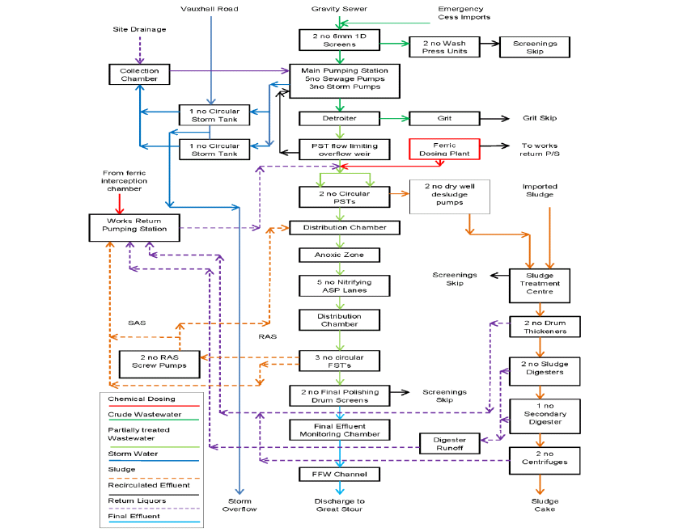
Connected to OCU
WtW
STC
Sludge Reception Tank
Return Liquors Well
Condensate
Liquors
Screens
CHP
Post Screening Storage Tanks
Flare
Gas Bag
Thickened sludge storage tank
Biogas
Boiler
Post digestion Storage Tank
Connected to OCU
Temporary Storage of sludge cake (raw or digested)
(separate waste activity)

Slide 2
Digested Sludge
(separate waste activity)
19 06 06
Connected to OCU

