Slide 1
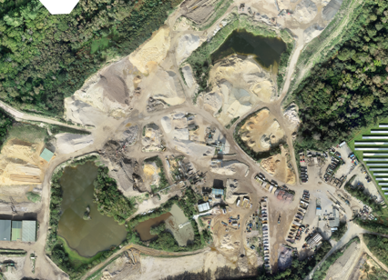

Waste management plan

Slide 2
Inert waste recovery flow chart
Waste producer Classifies the waste, contacts MB Wilkes
10mm soil
20mm soil
MB Wilkes Driver visits the Producers site. Confirms waste code on a transfer note collects the waste
Wessex sand
Root zone
Filling sand
Oversize
Oversize
Process
Soil Trommel operator Inspects load
Soil
Soft Sand
Sand plant operator to inspect load
Process
Process
Weighbridge receives the waste and transfer note. Inspects the load to confirm load description. TCM on hand to inspect if there is an issue. Send to relevant operation
Reject
Reject
Reject
Scalper Screen operator Inspects the load.
Mixed Inert
Non Recoverable
Concrete
Crusher operator to inspect load
Process
Process
Type1
Reject
Reject
Oversize
6F5
Fines
Wash plant
4/10mm
3” Crush
10/20mm
Land fill
20/40mm
Fines
40mm+
1A Fill
0/2 Sand
0/4 Sand
Finished products Tested and available for sale.
Ultra fine
Quarry Bunding / Restoration
Clay Soil

Slide 3
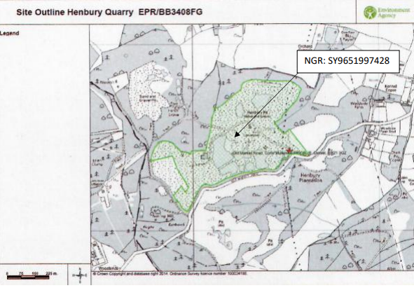
Waste permit boundary
All waste activities are carried out within this green area.

Slide 4
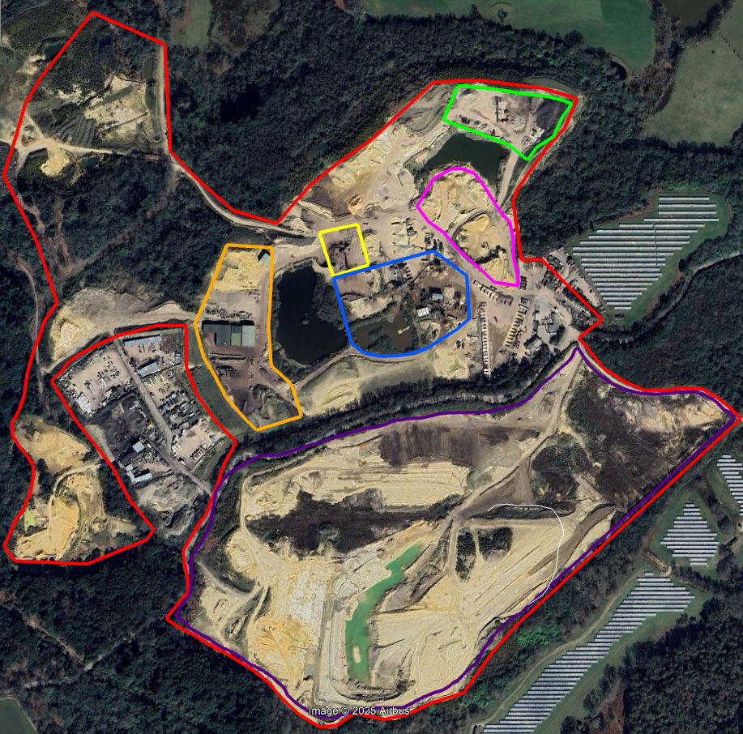
MB Wilkes Site plan
MB Wilkes Permit Boundary
Quarry area
Crushing operation
17 01 01, 17 01 02, 17 01 07, 17 03 02
Sand screening operation
17 05 04
Soil screening operation
17 05 04, 20 02 02
Inert screening Operation
17 05 04, 17 09 04
Wash plant Operation
17 05 04, 17 09 04
Stored inert waste waiting to be processed
Wash plant finished product loading area

Slide 5
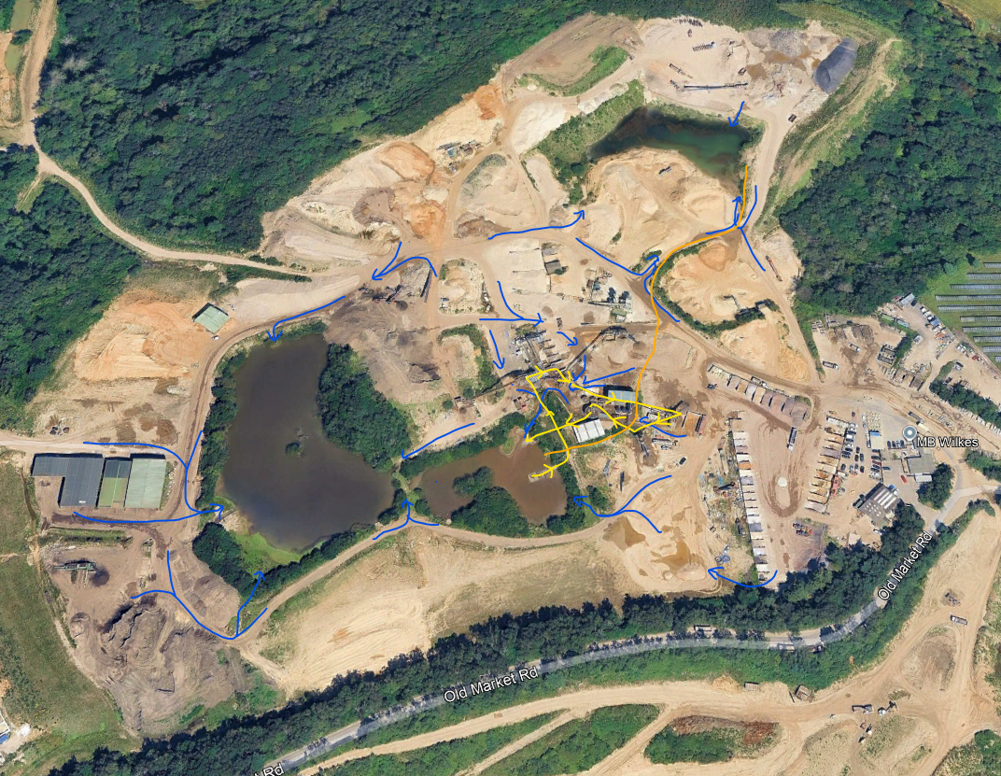
Waste operation water flow
Surface water run off
Water plant process water
Under ground transfer pipe
Wash plant supply pond. Clay lined
All surface water run off From the wash plant and related stocking areas is directed to the wash plant supply ponds.
The wash plant water supply is abstracted from pond 1. The wash water from the wash plant is treated with flocculant to remove the contaminants and then returned to pond 1.
Pond 2 is connected to pond 1 via a pipe so the level in these pond rise and fall together. The full capacity of both ponds is used for the wash plant operation.
Pond 3 is used as an ancillary storage pond. It is connected to pond 1 via an under-ground pipe. Water can be transferred between ponds depending on the requirement at the time
All of the working yard is founded on impermeable compacted London clay which is naturally under the extracted sand and gravel.
3
2
1

