Slide 1
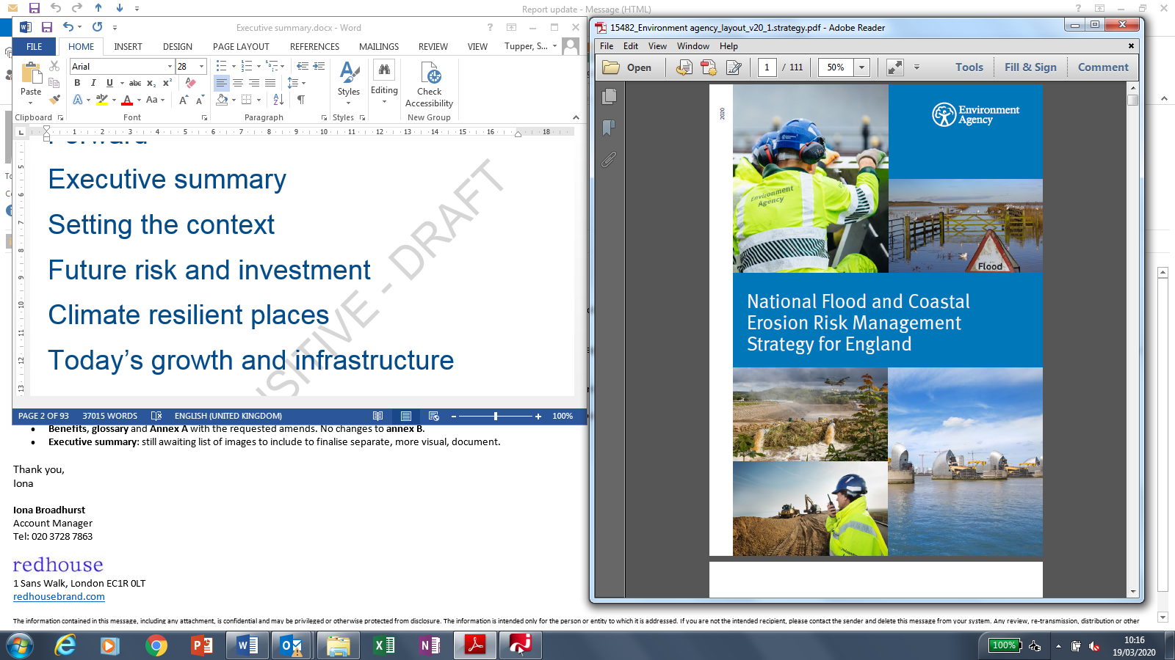
National Flood
and
Coastal Erosion
Risk
Management
(FCERM)
Strategy
Notes:
This slide pack provides information about the FCERM Strategy and is to:
Help people understand why we have a long term strategy for managing flooding and coastal change in England
Describe the big changes the strategy describes for managing flooding and coastal change
Explain the collaboration and consultation we have been through to lead to this strategy
Show how your work can start to deliver the strategy
Help partners and communities understand the strategy and the role they have to play
Depending on how long you have and where you want to focus your discussion, please feel free to delete any slides that you don’t need to use.

Slide 2
Contents
Why we need the FCERM Strategy - Slide 3
The vision and ambitions – Slides 4 to 10
Developing the new FCERM Strategy / wider links – Slides 11 to 12
The FCERM Strategy and climate change – Slide 13
Next steps – Slides 14
Action planning – Slide 15

Slide 3
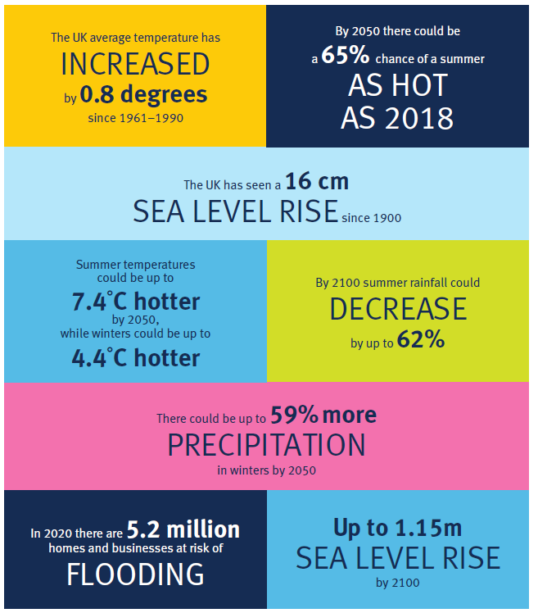
Why we need a new Strategy now
Climate change is happening now and is already causing more frequent, intense flooding and sea level rise.
The FCERM Strategy offers a new long-term approach to improve the resilience of the nation, setting out national ambitions for England that work for every place.
The FCERM Strategy has close alignment with the Defra flood and coastal erosion risk management policy statement
A nation ready for, and resilient to, flooding and coastal change
Notes:
The FCERM Strategy offers a long term approach to creating a climate resilient nation.
Why do we need a Strategy?
Climate change is happening now – the most recent climate change projections confirm we will experience wetter winters and drier summers, with an increased likelihood of more intense rainfall leading to flooding (see infographic to pick out key evidence).
The evidence exists – e.g. UKCP18. The opportunity is now with raised social awareness of climate change and increasing public demand for action to tackle the impacts.
What the Strategy will do differently
We need to move the nation from a concept of protection to one of resilience – traditional flood and sea defences will remain vitally important, but we cannot build our way out of future climate risks in many places.
In different places we will need a range of actions which enable us to prepare for, respond to and recover from flooding and coastal change. We can do this by improving the capacity of people and places to plan for, better protect, respond to, and recover from flooding and coastal change.
Our Strategy sets out a national ambition for England but one that can work for every place. We recognise that every place is different and there is no one size fits all solution to flood and coastal resilience. The only way of doing this is to put people at the heart of decision making.
Links to the Defra flood and coastal erosion risk management policy (2020)
Alongside the Strategy, Defra have published a new flood and coastal erosion risk management policy. This policy statement aligns well to the ambitions of the Strategy. Taken together, the Policy Statement and the Strategy will ensure that our country is more resilient to flooding and coastal erosion in the long term.

Slide 4
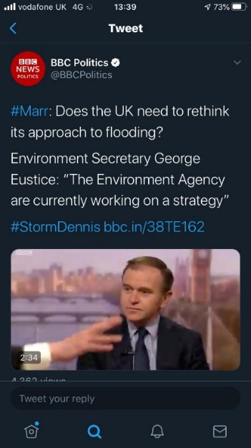
Flood and Coast Strategy: the vision is….
… a nation ready for, and resilient to, flooding and coastal change – today, tomorrow and to the year 2100.
“Climate change is making the UK warmer and wetter, and we will be visited by extreme weather more frequently in the future. So we need to shift gears, to ensure we adapt and become more resilient.”
George Eustice, Secretary of State for DEFRA
A nation ready for, and resilient to, flooding and coastal change
Notes:
The following slides explain the vision, ambitions and strategic objectives in more detail.
The Strategy sets out the long-term delivery objectives the nation should take over the next 10 to 30 years as well as shorter term, practical measures risk management authorities should take working with partners and communities.
The vision describes the long term outcome for the nation, but recognises that we need to start now.

Slide 5
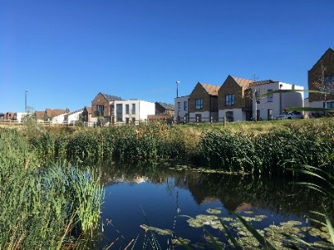


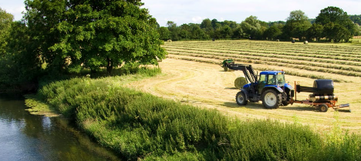
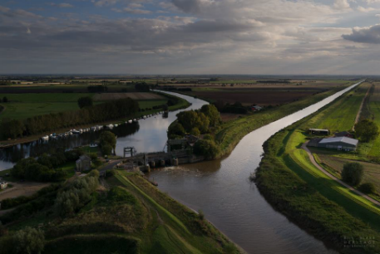




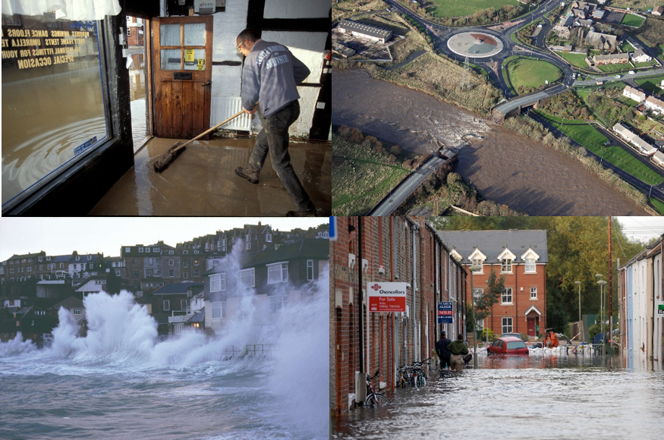

Strategy ambitions
Climate resilient places
Today’s growth and infrastructure resilient in tomorrow’s climate
A nation ready to respond and adapt to flooding and coastal change
A nation ready for, and resilient to, flooding and coastal change
Notes:
Our FCERM Strategy has three long term ambitions:
Climate resilient places
Working with partners to bolster resilience to flooding and coastal change across the nation, both now and in the face of climate change.
Today’s growth and infrastructure resilient in tomorrow’s climate
Making the right investment and planning decisions to secure sustainable growth and environmental improvements, as well as infrastructure resilient to flooding and coastal change.
A nation ready to respond and adapt to flooding and coastal change
Ensuring local people understand the risks posed by flooding and coastal change, are responsible for managing the impacts and know how to take action.
Evidence to understand future risk and investment needs
The three ambitions inform and are underpinned by continuing to develop our understanding of risk now and in the future. We also use this evidence to identify our investment needs. This narrative is featured as a preceding chapter to the three ambitions.

Slide 6
Climate resilient places
What will be better or different?
Risk management authorities will work with partners to:
Deliver practical and innovative actions that help to bolster resilience to flood and coastal change in local places.
Make greater use of nature-based solutions that take a catchment led approach to managing the flow of water to improve resilience to both floods and droughts.
Maximise opportunities to work with farmers and land managers to help them adapt their businesses and practices to be resilient to flooding and coastal change.
Develop adaptive pathways in local places that equip practitioners and policy makers to better plan for future flood and coastal change and adapt to future climate hazards.
A nation ready for, and resilient to, flooding and coastal change
Notes:
Climate resilient places
We must continue to do what we have been doing: building and maintaining strong defences to reduce the risk of places being flooded. In the face of a changing climate, we need to also make our places more resilient to flooding and coastal change, so that when it does happen it causes much less harm to people, does much less damage, and ensures life can get back to normal much quicker.
Alongside flood and sea defences, we need a broader range of actions for achieving climate resilient places. This includes using nature based solutions to slow the flow of or store flood waters and avoiding inappropriate development in the floodplain and it involves better preparing and responding to flood and coastal incidents through timely and effective forecasting, warning and evacuation. Furthermore, it needs to be about helping communities and local economies recover more quickly after a flood or ‘building back better’ so that properties and infrastructure are more resilient to future flooding.
Looking out to 2100, we need to help places better plan and adapt to flooding and coastal change across a range of futures. This will mean being agile to the latest climate science, growth projections, investment opportunities and other changes to our local environment. We call this ‘adaptive pathways’ that enable local places to better plan for future flooding and coastal change and adapt to future climate hazards.
As a nation we need to improve the way we integrate adaptation to flooding and coastal change into daily activities and projects, as well as long term strategic investment plans and strategies for places and catchments. By doing so we can better equip practitioners and policy makers to make the best decisions, taken at the right time to benefit people, infrastructure, the economy and the environment. For example, working with farmers and land managers to help them adapt their businesses and practices to be resilient.
In some places the scale and pace of future flooding and coastal erosion will be very significant. The use of adaptive approaches or “pathways” in local places can equip people in communities to plan for the future. Over a period of time, some of these communities may choose to transition and adapt with support from risk management authorities.

Slide 7



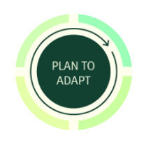







Embedding a new approach to resilience
IMPROVE PLACEMAKING:
Making the best land use and development choices to manage flooding and coastal change
BETTER PROTECT:
Building and
maintaining defences
and managing
the flow of water
RECOVER QUICKLY:
Getting back to normal and building back better
READY TO RESPOND:
Preparing for and
responding effectively
to incidents
A nation ready for, and resilient to, flooding and coastal change
Notes:
Embedding a new approach to resilience
This Strategy calls for the nation to embrace a broad range of resilience actions alongside better protection to flooding and coastal change.
We must continue to do what we have been doing: building and maintaining strong defences to reduce the risk of places being flooded. For example, see Slide 8 about the Thames Estuary.
But building our way out of managing future climate risks will not always be the right approach, particularly as the changing climate drives more extreme weather patterns, higher rainfall in shorter periods, and faster coastal erosion.
The consensus from practitioners who have contributed to the development of this Strategy is that flood and coastal resilience involves the capacity of people and places to: Plan for, better protect, respond to, and to recover from flooding and coastal change.
This includes:
Making the best land use and development choices, better protecting people and places, responding to and recovering from flooding and coastal change whilst all the time adapting to climate change.
There are four approaches to managing flood and coastal resilience that risk management authorities can progress with partners. They are to:
Improve place making: Making the best land use and development choices for managing flooding and coastal change
Better protect: Building and maintaining defences and managing the flow of water in a catchment or a place
Ready to respond: Planning for and responding effectively to incidents
Recover quickly: Getting back to normal and building back better.

Slide 8
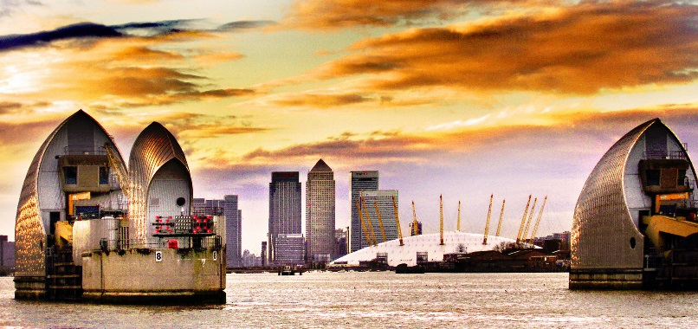
What are adaptive pathways?
Case study:
Thames Estuary 2100 Plan
The Thames Estuary benefits from a world-class system of defences providing protection to 1.3 million people and £275 billion of property and infrastructure from flooding.
The Thames Estuary 2100 Plan was developed to provide strategic direction for managing flood risk to the end of the century.
Looking out to 2100, we need to help local places better plan and adapt to future flooding and coastal change.
This will mean being agile to the latest climate science, growth projections, investment opportunities and other changes to our local environment.
‘Adaptive pathways’ enable local places to better plan for future flooding and coastal change and adapt to future climate hazards.
We need to improve the way we integrate adaptation to flooding and coastal change into daily activities and projects, as well as long term strategic investment plans and strategies.
Notes:
Adaptive pathways
Whilst we have more certainty of what a changing climate will be like in the future, planning for it is uncertain which can sometimes feel daunting. It is easier to plan for one future climate but much more difficult to plan for a range. Planning for climate adaptation is a way of managing these uncertainties which should enable investment in resilience actions at the points when they will provide maximum benefit. This ultimately avoids situations where investment in flood and coastal resilience is too early, too late or critically, too little avoiding unnecessary flooding and recovery costs.
For practitioners and policy makers, this means remaining agile to the latest climate science, growth projections, investment opportunities and other changes to our environment, to ensure that the capacity to adapt is built into all investment decisions. Flooding and coastal change requires an adaptive approach that equips local decision makers to identify the best combination of resilience actions and the right time to take action. It’s also vital to secure buy in from local partners to make adaptation happen.
We call this ‘adaptive pathways’ that enable local places to better plan for future flood and coastal change and adapt to future climate hazards. Taking an adaptive approach is recommended in the government’s Green Book Supplementary Guidance and can reduce overall costs by improving the timing and effectiveness of investments. Adaptive pathways can help to ensure that as a nation we can be more economically resilient to future climate hazards to better manage future flood and coastal risks.
Looking out to the year 2100, we need to help local places better plan and adapt to future flooding and coastal change - every place needs to identify the decisions for managing flooding and coastal change to be taken now and those which can be made in the future.
The Thames Estuary is a clear example of this approach. The Thames Estuary 2100 plan determines the best long term investment options for London’s tidal defences, including when to construct a new Thames Barrier. The plan identifies a series of approaches for different climate, social and economic futures to inform a long-term investment plan to ensure the actions taken by all partners are the right ones, taken at the right time to benefit London’s people, the environment and the economy. The approach taken in the Thames Estuary is scalable - to be proportionate to the flood and coastal risks facing other places in the country.

Slide 9
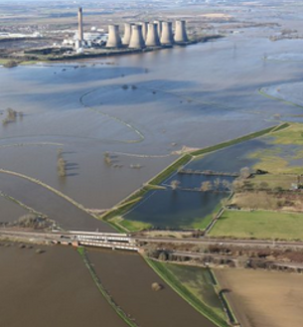
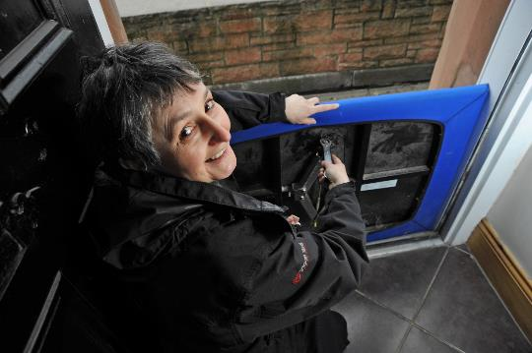
Today’s growth and infrastructure resilient in tomorrow’s climate
What will be better or different?
Risk management authorities will work with partners to:
Put greater focus on providing timely and quality planning advice that helps avoid inappropriate development in areas at risk of flooding and coastal change.
Leave the environment in a better state by contributing to environmental net gain for new development proposals.
Ensure that spending on flood and coastal resilience contributes to job creation and sustainable growth in local places.
Mainstream property flood resilience measures and to ‘build back better’ after flooding to reduce damages and enable faster recovery for local communities.
Provide expert advice on how infrastructure providers (road, rail, water and power supplies) can ensure their investments are more resilient to future flooding and coastal change avoiding disruption to peoples’ lives and livelihoods.
A nation ready for, and resilient to, flooding and coastal change
Notes:
Today’s growth and infrastructure resilient in tomorrow’s climate
This Strategy sets out a long-term objective for risk management authorities to work with infrastructure providers to ensure all infrastructure investment is resilient to future flooding and coastal change. Over two-thirds of properties in England are served by infrastructure sites and networks located in, or dependent on others located in, areas at risk of flooding. Recent floods have demonstrated the vulnerability of critical infrastructure, such as electricity sub-stations and water treatment plants, causing considerable disruption and economic damage.
As the population grows, we are likely to see the number of properties in the flood plain almost double over the next 50 years. We must ensure that all new development is resilient to flooding and protects and enhances the environment. Risk management authorities have a key role to play in engaging and advising developers and planners to get the right kind of sustainable growth in the right places. They should also be seizing opportunities for flood and coastal resilience to play its part in contributing to environmental net gain for development proposals.
This Strategy identifies ways in which investments made to adapt to the threats from flooding and coastal change can enable growth in a sustainable and climate resilient way. More focus is also needed on encouraging property owners to ‘build back better’ (see definition below) after a flood and to mainstream property flood resilience measures that reduce flood damages and enable faster recovery for local communities.
“Build back better” definition: Re-building properties, businesses and infrastructure after a flood or coastal change event in a way which reduces future damages and improves resilience, rather than putting back what was there before.

Slide 10
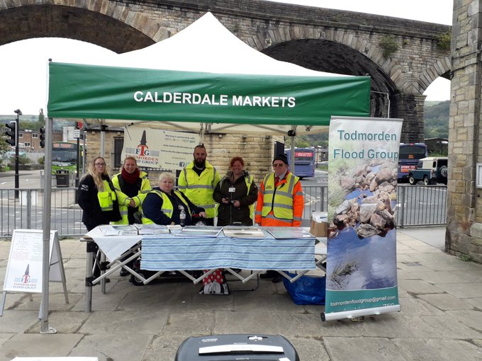
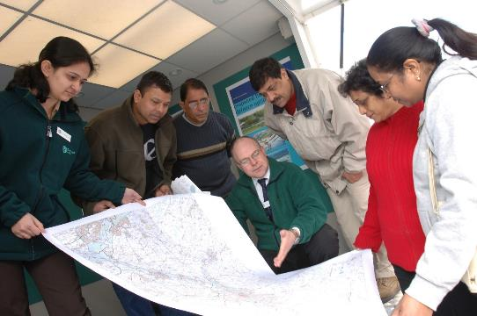
A nation ready to respond and adapt to flooding and coastal change
What will be better or different?
Risk management authorities will work with partners to:
Support communities to better prepare and respond to flooding and coastal change, including transforming how people receive flood warnings
Ensure people and businesses receive the support they need from all those involved in recovery so they can get back to normal quicker after flooding
Help support communities with managing the long-term mental health impacts from flooding and coastal change
Develop the skills and capabilities needed to better support communities to adapt to future flooding and coastal change
Become a world leader in the research and innovation of flood and coastal risk management to better protect current and future generations
A nation ready for, and resilient to, flooding and coastal change
Notes:
A nation ready to respond and adapt to flooding and coastal change
This Strategy seeks to build a nation of people who understand the risks posed by flooding and coastal change, are responsible for managing the impacts and know how to take action. Over 5.2 million homes and properties in England are at risk from flooding and coastal erosion. Yet only a third of people who live in areas at risk of flooding believe their property is at risk. Many more people are affected when transport services, energy or water infrastructure are damaged or disrupted. For every household directly affected during a large flood, about 16 people suffer knock-on effects from losses of utility services.
We have a developed a strong flood forecasting and warning service that provides people, businesses and the emergency services with information to help them prepare for a flood. Over 1.4 million properties are signed up to receive free flood warnings. The Environment Agency will continue to work with partners to transform its warning and informing services to better reach people living, working or travelling though flood risk areas. We also need to continue to develop digital services that better communicate flooding and coastal change and increase awareness of the risks people face. Risk management authorities, local responders and the insurance sector also have a key role to play in helping people and businesses recover more quickly after flooding. We also need to be better at mobilising support from the third sector following significant flooding.
The threats posed by a changing climate are a global challenge and we are not facing them alone. We want our nation to be recognised as a world leader in researching and managing flooding and coastal change. Meeting the challenge of reaching net zero carbon emissions by 2050 will need new ideas and innovation across all sectors. Through this Strategy we need to actively develop the skills and talent we need to create the climate resilient places of the future.

Slide 11
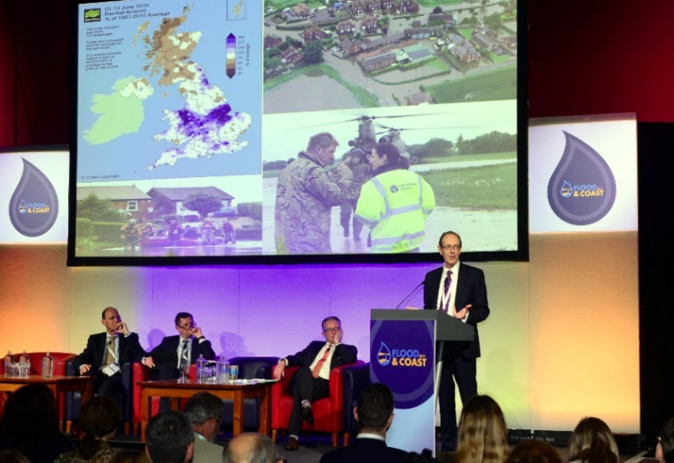
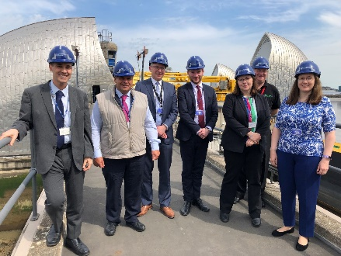
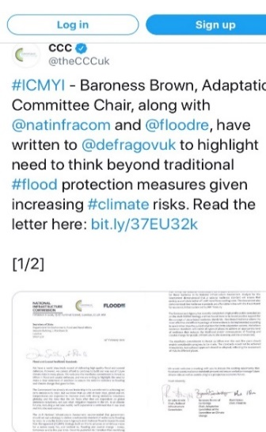
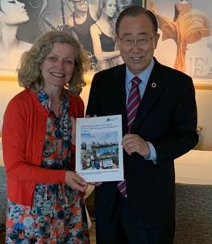
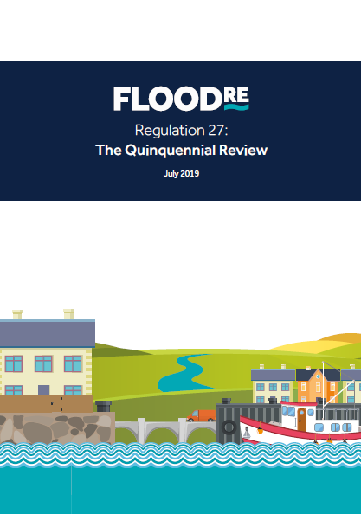
Positive stakeholder support
Largest national consultation run by EA - 400 external responses received over Summer 2019
Significant support for Strategy’s ambitions, objectives and measures
The Strategy provides a framework for guiding the operational activities and decision making of practitioners supporting the direction set by government policy – including Defra’s 2020 flood and coastal erosion risk management policy statement.
A nation ready for, and resilient to, flooding and coastal change
Notes:
Legislative requirement
The Flood and Water Management Act 2010 requires the Environment Agency to “develop, maintain, apply and monitor a strategy for flood and coastal erosion risk management in England
The first National FCERM Strategy was published in 2011
Case for change
Huge progress has been made since the National Flood and Coastal Erosion Risk Management (FCERM) Strategy for England was first published in 2011. Risk management authorities, working with local partners, will have invested £2.6 Bn of government funding in flood and coastal risk management, better protecting 300,000 homes between 2015 and 2021. In the Budget 2020, the government committed to doubling expenditure on FCERM to £5.2 billion between 2021 and 2027. This record-breaking spending will better protect a further 336,000 homes and properties as well as avoid £32 billion of wider economic damages to the nation.
Government policy and evidence has evolved since the 2011 Strategy. In 2018, the government’s 25 Year Environment Plan published its aspiration to be the first generation to leave the environment in a better state than when we found it. The 2018 UK Climate Change Projections also stated that average sea levels could increase by over a metre by the end of the century.
In 2019, the government set a new UK target to bring all greenhouse gas emissions to net zero by 2050. The government’s Environment Bill and Agriculture Bill recognised that we need to make nature’s power part of our solution, as well as supporting farmers and land managers to help reduce flood risk through the Environmental Land Management scheme.
Collectively, improvements in our understanding of climate science, learning from flood events and developments in government policy mean that now is the right time for a new Strategy.
The Strategy provides a framework for guiding the operational activities and decision making of practitioners supporting the direction set by government policy, which includes its flood and coastal erosion risk management policy statement.
Formal consultation
During 2019, we consulted on a new draft FCERM Strategy for England. We also consulted on the Strategic Environmental Assessment (SEA) environmental report and a draft Habitats Regulations Assessment (HRA).
Over 150 people were involved from 90 organisations. These included public, private and voluntary sector organisation An Advisory Group was set up and continued to oversee and steer the work up and including evaluation of consultation responses.

Slide 12
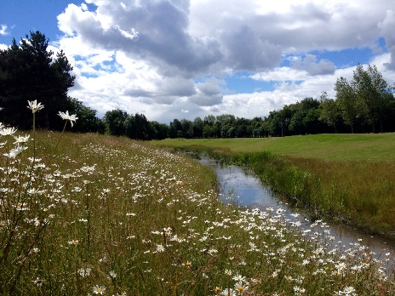
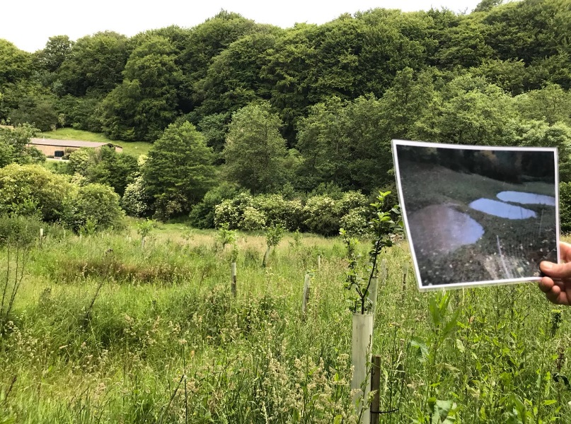
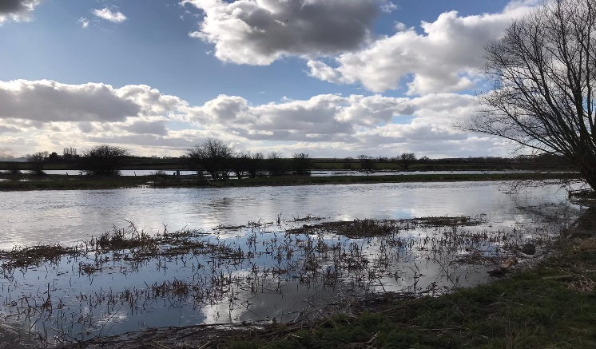
Supporting documents
Strategic Environmental Assessment (SEA)
Habitats Regulations Assessment (HRA)
Consultation response document
A nation ready for, and resilient to, flooding and coastal change
Notes:
Alongside the Strategy, we undertook a strategic environmental assessment and a Habitats Regulations Assessment. We also prepared a consultation response document. These documents are now published alongside publication of the final Strategy, following parliamentary scrutiny.
Strategic environmental assessment (SEA)
This is an assessment process which aims to ensure that environmental and other sustainability aspects are considered effectively in policy, plan and program making.
The SEA environment report sets out the findings of the assessment. The report was published alongside the draft Strategy ahead of formal consultation. The report found that the Strategy is likely to have mostly positive or neutral effects at a national scale, that the Strategy aligns with other relevant national strategies, including commitments in the 25 year Environment Plan.
The Strategy took account of mitigation and enhancement measures set out in the SEA environmental report. The SEA Statement of Environmental Particulars describes how we did this as well as how we addressed responses to the public consultation.
Habitats Regulations Assessment (HRA)
A HRA is required under the Conservation of Habitats and Species Regulations 2017 to analyse potential implications of the Strategy on European sites and species. We published the draft HRA for the formal consultation of the draft Strategy and worked with Natural England to prepare the final HRA.
The HRA identifies measures to mitigate potential adverse effects for European sites from Strategy implementation. We took account of these measures when finalising the Strategy.
The Strategy has mitigated for detrimental impacts by being clear that protecting and enhancing the environment is incorporated into future FCERM plans and projects. The EA has programmes for future implementation of compensatory measures. Adopting the Strategy is also necessary for imperative reasons of overriding public interest related to human health and public safety.
Due to future uncertainty about how sites will respond to climate change, the Strategy has a role in improving the resilience to climate change effects, such as reversing habitat fragmentation.
Consultation response document. Our document will set out:
How we approached the public consultation, he most important issues that emerged from the responses and how the final Strategy has taken account of the feedback received.
The responses to the strategic environmental assessment (SEA) and habitats regulations assessment (HRA) at a high level

Slide 13

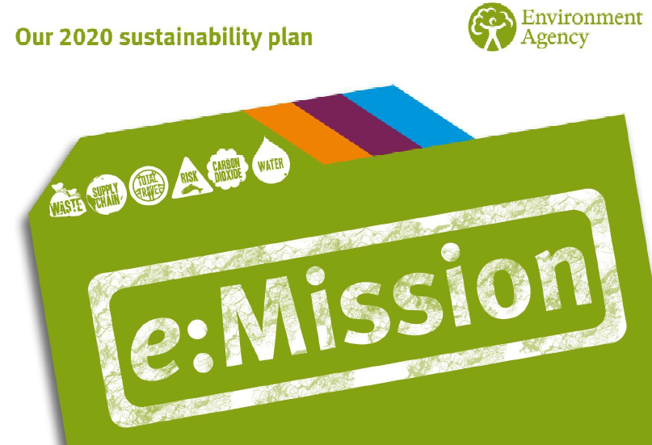
Net Zero by 2030
We need to both limit future climate change as well as adapt to the climate change that now cannot be stopped.
A nation ready for, and resilient to, flooding and coastal change
Notes:
Net Zero by 2030
The Environment Agency has set itself a goal to become a net zero organisation by 2030 - this means that, by 2030, we will aim to balance the carbon emissions we produce with those we take out of the atmosphere so that we are no longer contributing to climate change. We are also exploring whether it can become an absolute zero organisation – one that does not produce any carbon emissions at all – by 2050.
We will seek to reduce our emissions (currently 44,000 tonnes a year) by at least 45% by 2030 and offset the impacts of its remaining emissions through tree planting and other measures that will lock up carbon harmlessly and deliver other benefits such as improving habitats. We will adopt an approach that not only accounts for the carbon emissions we produce ourselves but also those produced through our supply chain (currently 136,000 tonnes a year).
This does not mean the we will stop building flood and coastal defences or pumping water out of people’s homes if they flood. But it does mean that over time, and working with our partners, we will need to find better ways to be more resilient to flooding and coastal change whilst producing fewer emissions.

Slide 14
Next steps
Autumn / Winter 2020
Final Strategy published and adopted following parliamentary scrutiny
Consultation response document published
Summer 2020 to Spring 2021
Action planning with partners and stakeholders
Spring 2021
Partner action plan published
SEA Statement of Environmental Particulars and Final HRA published
A nation ready for, and resilient to, flooding and coastal change
Notes:
Next steps
With the final strategy now published and adopted following parliamentary scrutiny, we can now publish the Strategic Environmental Assessment Statement of Environmental Particulars as well as the final Habitats Regulations Assessment. The SEA environmental report has already been published back in 2019.
We will also be working closely with our partners to develop a detailed action plan to set out how we will deliver the Strategy objectives. This work is captured after this ‘Next Steps’ slide.
As part of this, we will need to agree arrangements for monitoring and reporting, including metrics development.
In light of the Coronavirus, we will approach our partners and stakeholders with great care and adjust our engagement on the action plan as necessary, appreciating any challenges that our partners may be facing.

Slide 15

Action Plan
Work with partners to identify a shared set of practical actions for the first 5 years of the Strategy
The action plan will be a national framework to inspire and drive local action.
The action plan will be web based, accessible to our partners and the public where actions are owned and updated.
We will report progress on the action plan to the Minister.
Notes:
Action Plan
To help us turn the measures within the strategy into practical action, we will engage with partners to create an action plan.
In light of the Coronavirus, we will approach partners with great care and adjust our engagement if necessary, appreciating the challenges that our partners may also be facing.
The action plan will capture national actions that will start to deliver the measures over the next 5 years. The action plan will be available to the public and local partners to inspire practical delivery locally.
The action plan is being developed so that it is web based and accessible to our national partners. This will enable the EA and our partners to keep their actions up to date and ‘live’, so we can all track our progress.
We aim to track and report on progress frequently. This will be informed by discussions with our partners and stakeholders.
The action plan will be published in Spring 2021.

Slide 16
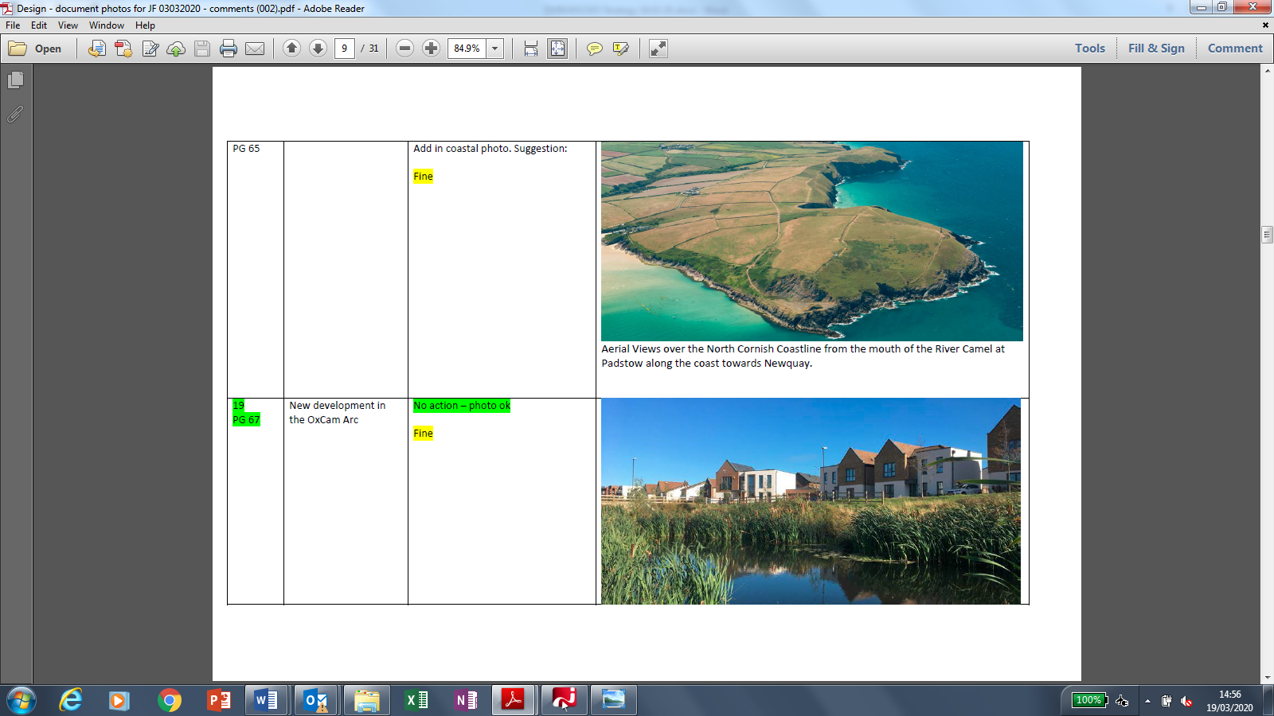
Strategy and other docs are at gov.uk
Contact the Environment Agency’s Strategy Team at FCERMstrategy@environment-agency.gov.uk
A nation ready for, and resilient to, flooding and coastal change

